Slide 1

Pharma sales
Project by : Rawad Okla

Slide 2
Introduction
This data shows the sales of various drug categories in the time period between 2014 and 2019 according to year, month, day and hour.
In this presentation, I will be showing insights about the data after cleaning process while answering questions to identify the project aims and goals.

Slide 3
Problem: detect the selling pattern and which is the highest and lowest category to work on developing marketing strategies or identify the reasons
Goals: 1- what is the sales averages (year, quarter and month) 2- what are the highest and lowest sellers 3- what is the selling percentage for each category 4- what is the sales trends

Slide 4
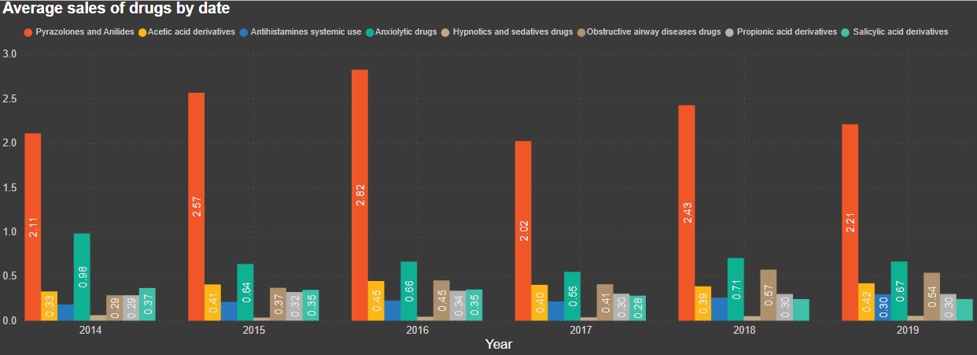
Sales averages

Slide 5
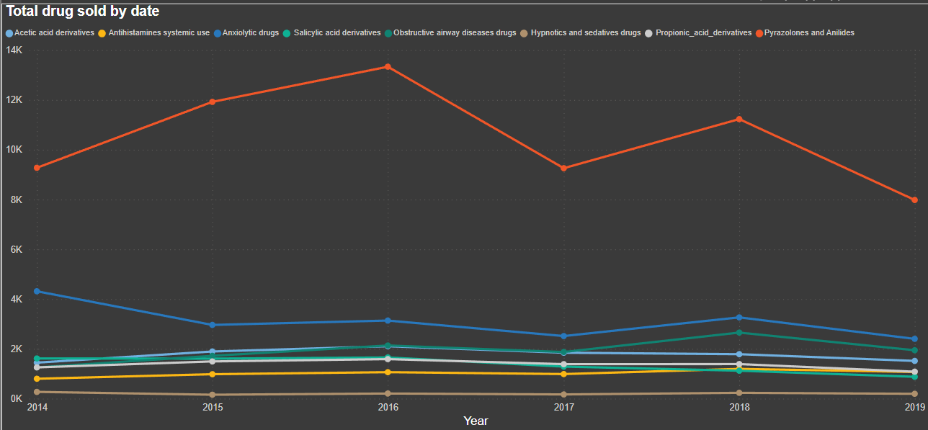
Total sales

Slide 6
As we can see the highest selling drugs are Pyrazolones and Anilides , while the lowest are Hypnotics and sedatives drugs
It can be because Hypnotics and sedatives drugs are Rx only drugs while Pyrazolones and Anilides are OTC widely used for various cases .

Slide 7
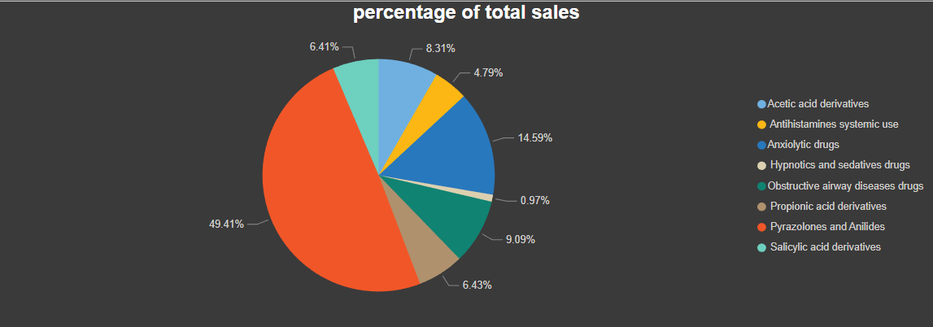
Selling percentages

Slide 8
Trends (year)
The overall sales tend to be decreasing , for the highest selling it increased between 2014 and 2016 then it generally decreased . (The sales in 2019 is lower than 2014)
For the other groups it is quite steady

Slide 9
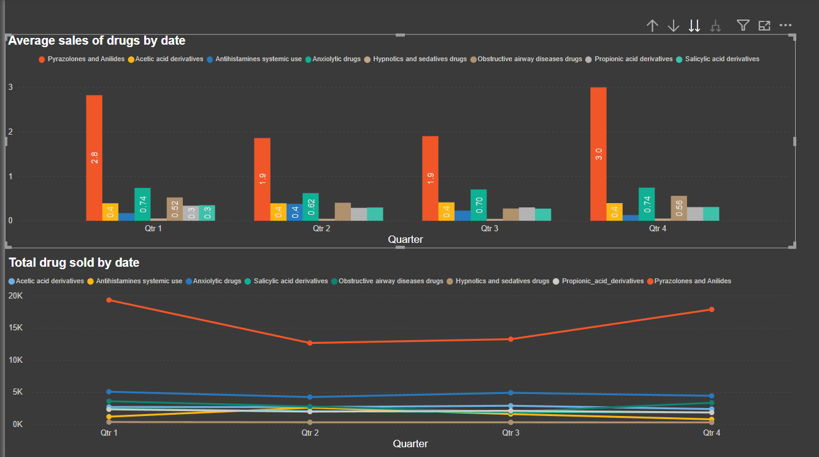
Trends (Quarters)
It seems that for the highest selling group , (sales decrease in Q2 and Q3 then increase in Q4 to reach the same level as Q1)
For the other groups, changes are negligible

Slide 10
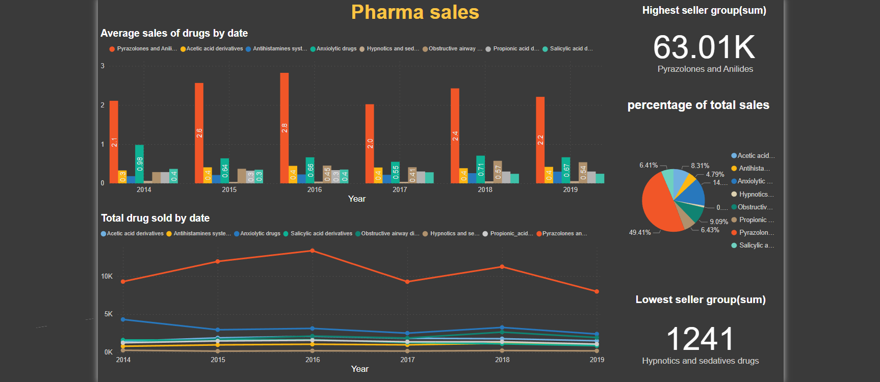
Overall look

Slide 11
Conclusion
The data is not enough to determine the reasons for the selling trends, although there might be pharmaceutical explanation (efficacy, adverse effects and prescription) or marketing explanation .

